Slide 1
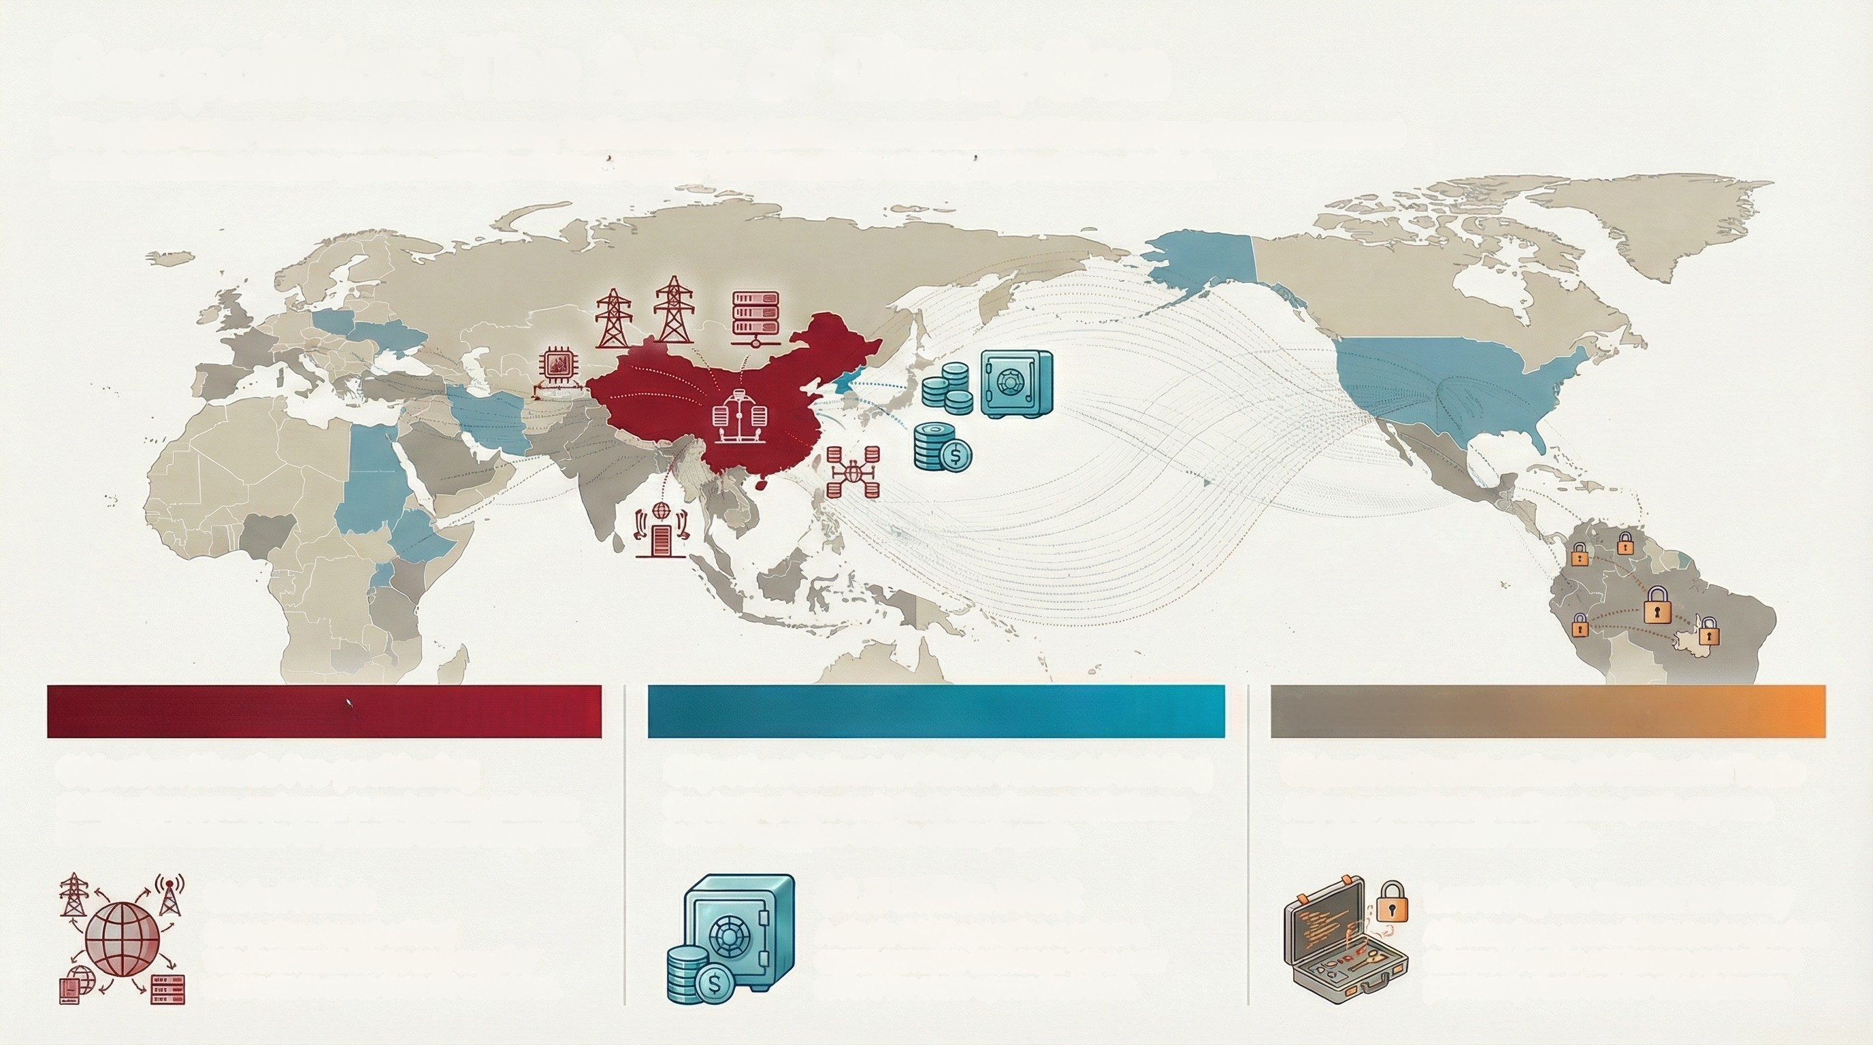
Geopolitics: The Axis of Disruption
The global cyber landscape is undergoing "balkanization," dividing into geopolitical blocs where state-sponsored
actors and mercenaries pursue unique strategic goals, fundamentally reshaping modern conflict.
CHINA (Salt Typhoon)
Objective: Kinetic Pre-positioning
Shifting from pure espionage to embedding malware
in critical infrastructure for potential future disruption.
NORTH KOREA (Lazarus Group)
MERCENARIES (Hacking Team)
Objective: Industrial-Scale Financial Raiding
Conducting large-scale theft from financial platforms
to fund the regime and its strategic goals.
Objective: Proliferation of Offensive Tools
Acting as enablers by selling state-grade spyware
and exploits to smaller nations.
Global Reach
Campaigns target critical
telecommunications and supplier
networks in more than 80 countries.
$1.5 Billion Heist
A single 2025 operation against a
cryptocurrency exchange set a new
record for state-sponsored theft.
Lowering the Barrier to Entry
Allowing less powerful states to conduct
advanced cyber-espionage operations
previously reserved for superpowers.

